Slide 1
Introduction to Visual Studio 2010 and C#

Slide 2
Information in this document is subject to change without notice. The example companies, organizations, products, people, and events depicted herein are fictitious. No association with any real company, organization, product, person or event is intended or should be inferred. Complying with all applicable copyright laws is the responsibility of the user.
Microsoft may have patents, patent applications, trademarked, copyrights, or other intellectual property rights covering subject matter in this document. Except as expressly provided in any license agreement from Microsoft, the furnishing of this document does not give you any license to these patents, trademarks, or other intellectual property.
© 2011 Microsoft Corporation. All rights reserved.
Microsoft, MS, Windows, MSDN, Visual Basic, Visual C++, Visual C#, and Visual Studio are either registered trademarks or trademarks of Microsoft Corporation in the U.S.A. and/or other countries.
Other product and company names herein may be the trademarks of their respective owners.
Microsoft Biology Initiative Training by Microsoft Corporation is licensed under a Creative Commons Attribution 3.0 Unported License. Based on a work at research.microsoft.com/bio.

Slide 3
Agenda
Introduction to Microsoft Visual Studio
Creating Projects with Visual Studio
What is .NET Programming?
Introduction to the C# Language
Debugging with Visual Studio

Slide 4
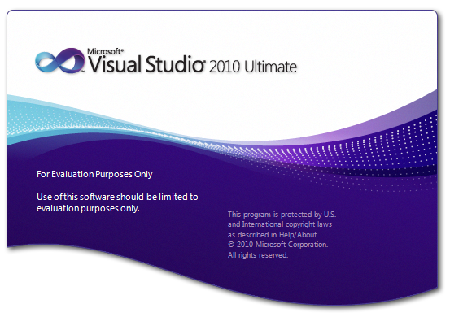
Welcome to Visual Studio
Visual Studio is Microsoft's Development Environment
complete development tool in one package
supports variety of languages and targets
Notes:
Visual Studio is the one-stop application for any developer targeting a Microsoft platform. It includes support for pretty much every language, operating system, platform and system built by Microsoft. It is an extensible and customizable development environment that is used to develop, debug and test applications.
It currently ships in a couple of different SKUs – depending on the SKU installed you may get slightly different features. The most desirable version is the "Ultimate" edition which includes pretty much every feature available. There are also academic editions that target specific markets (desktop or web development).

Slide 5
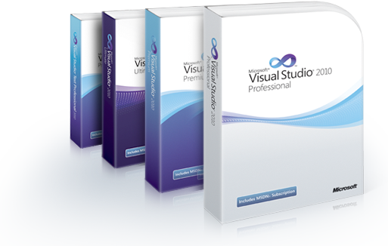
Versions
Visual Studio comes in several "flavors"
Academic and Enterprise licenses available via MSDN
trial versions available (http://www.microsoft.com/vstudio)
free versions available to students (http://www.dreamspark.com)

Slide 6
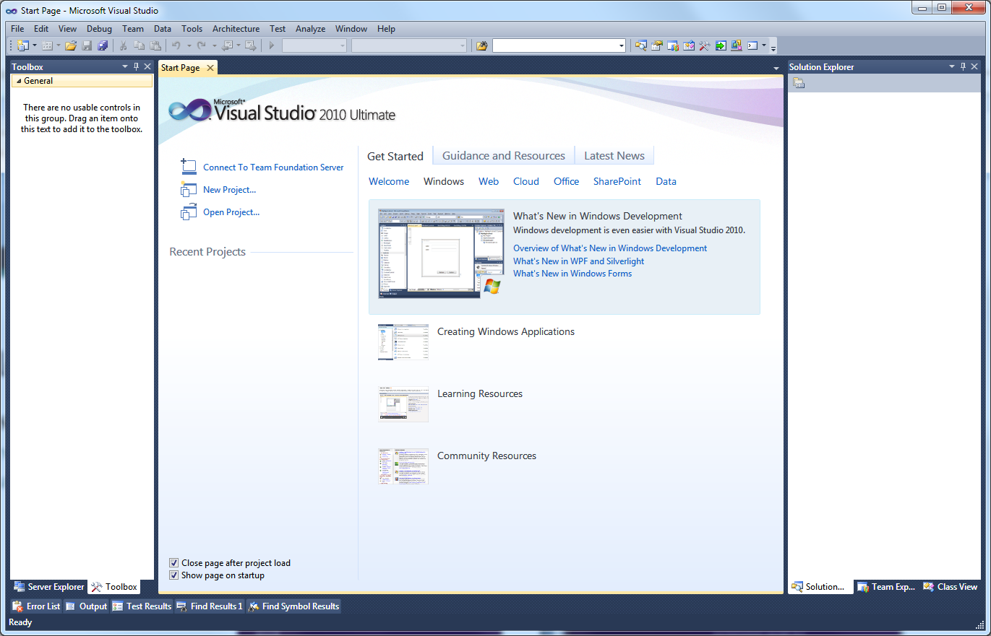
Customizing the environment
Highly customizable to fit your workflow and preferences
panels can be repositioned, collapsed, docked or even set to float on their own
tabs let you focus on specific elements
collapsed items allow you to maximize screen space
Notes:
When you first start Visual Studio, it will ask you for the "development" settings you want to use. Make sure you choose "General Development" – this will ensure that all the menu options are present and available to you. Other choices turn things on and off based on what the team felt you need. If you've already chosen some other settings, you can always reset them back to "General" through the Tools | Import and Export Settings | Reset All Settings menu option.

Slide 7
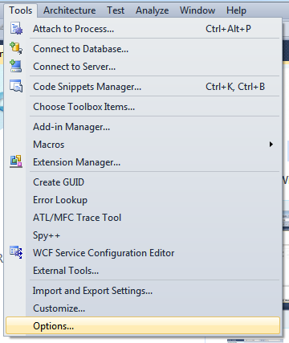
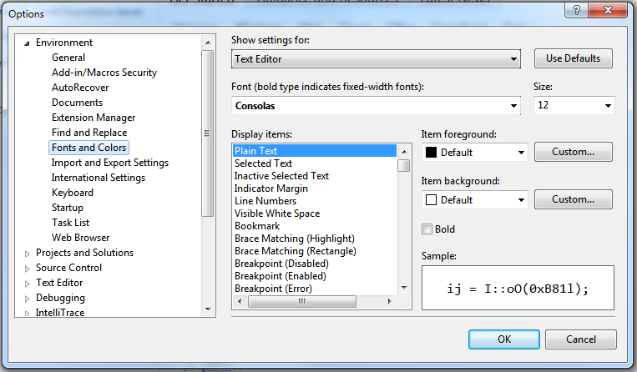
Customizing the Colors and Fonts
Colors, fonts, formatting and even key bindings can all be changed through the options
Notes:
The level of customization in this IDE is just incredible. You can make the text editor itself look and almost act like almost any other popular editor.

Slide 8
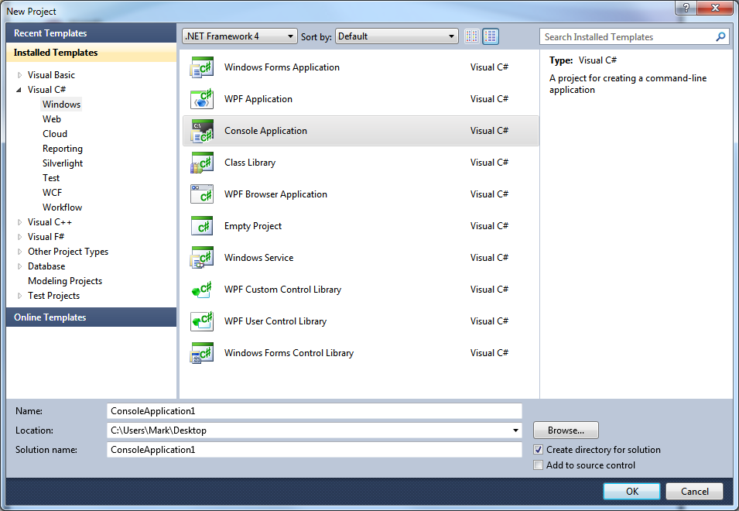
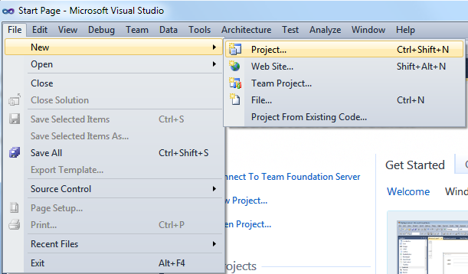
Creating Applications
Applications are generated from a template
VS includes a variety of "starter" templates
can also add custom templates

Slide 9
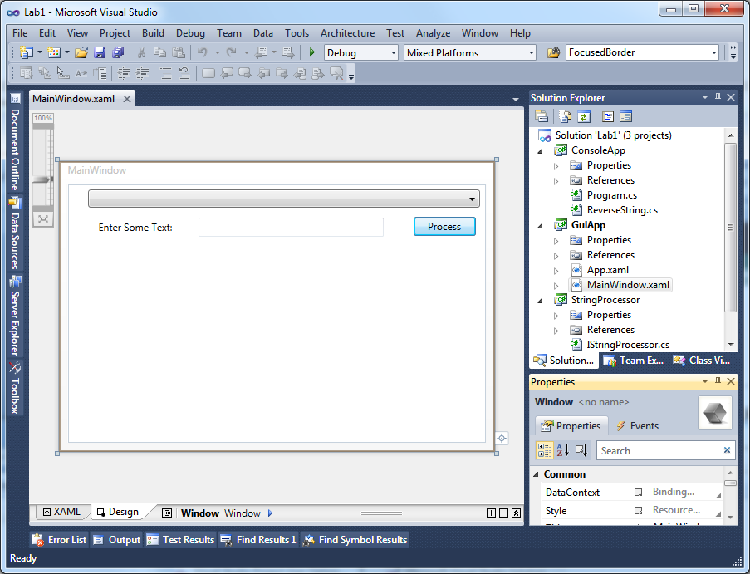
Working with your solution
Template generates Solution and Project
Solutions hold one or more related projects
Projects generate output
Solution Explorer shows all the loaded projects together

Slide 10
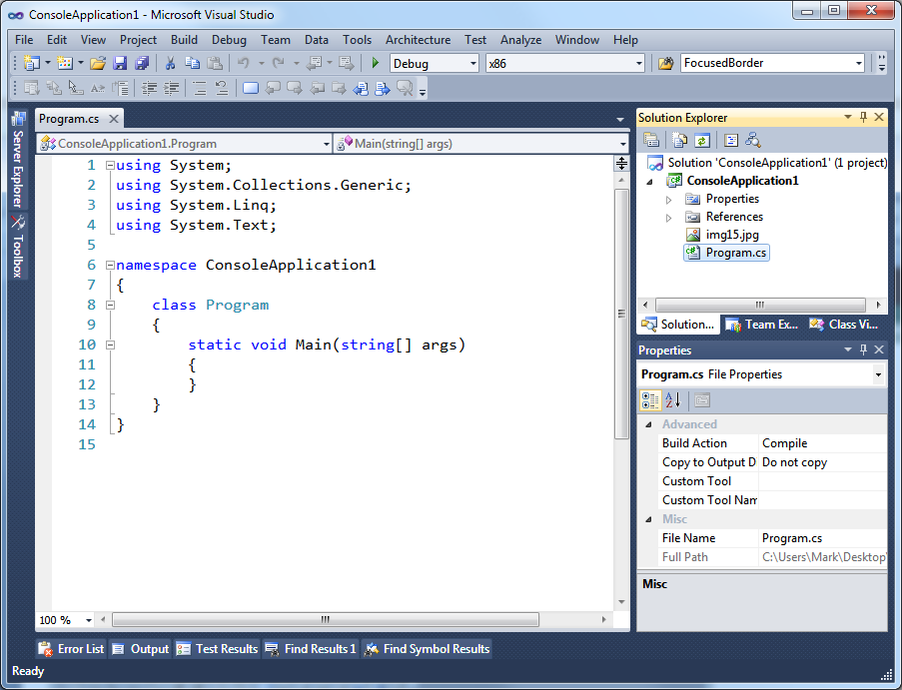
Project Structure
Projects contain source code and assets
generates executable output
project contains source file – program.cs and resource asset img15.jpg
properties decide how specific file is treated within project through build action

Slide 11
What is .NET?
.NET is a set of technologies to build applications
Common Language Runtime (CLR)
Runtime Services
Programming Languages
C#
Visual Studio 2010
Class
Libraries
Core classes
Security
Garbage Collector
F#
…
VB.NET
…
I/O
GUI
Custom classes
Tools
Compilers
.NET Reflector + ILDASM

Slide 12
Common Language Runtime (CLR)
CLR manages runtime execution
"Just in Time" (JIT) compilation to native code
Garbage Collection and memory management
Security and hosting
CLR reads Intermediate Language (IL)
compilers convert source code into IL
IL is JIT-compiled into native instructions
class Person
{
string Name;
void SayHello() {…}
}
.class private Person
{
.field private string Name
.method SayHello() { ... }
}
x86
X64
IA64
…

Slide 13
Class Libraries
Most of .NET resides in the class libraries
challenge is knowing what is where!
Collections
XML
Database
File/Network I/O
Web Services
GUI
Security
Threading
…and much, much more

Slide 14
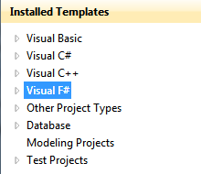
Programming Languages
.NET allows for cross-language development
can choose the appropriate language for the task
Over 100 languages target the .NET platform
Eiffel, Pascal, COBOL, Fortran, Boo, Python, …
Most developers tend to use one or two
C# and VB.NET are the most common choices
we will focus on C#
Developer chooses specific language when they create the project – each project supports one language

Slide 15
Deployment
.NET applications are composed of assemblies
versioned and packaged separately
generally copied together in same directory
Assembly contains code + data + metadata
Metadata (runtime requirements, target platform, security, etc.)
Data (Resources, strings, Images, etc.)
Code (Intermediate Language)

Slide 16
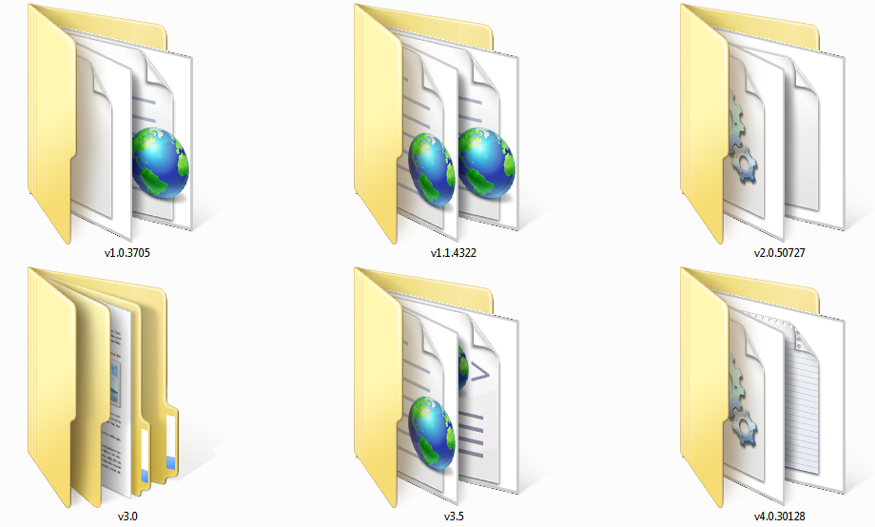
Installing .NET on the client
.NET installed through web or standalone .MSI
core files placed in C:\Windows\Microsoft .NET\Framework
multiple versions can coexist (each in a unique directory)
Apps know .NET version they were compiled for
stored in metadata of the assembly
require specific version or later is installed to run
Framework directory contains the specific executable version of CLR – allowing multiple versions to be installed simultaneously

Slide 17
Introducing C#
C# is similar in many ways to existing languages
case sensitive language
same basic mathematical operators as Java and C/C++
same single-inheritance object hierarchy as Java
same comment structure as Java and C++
statements are terminated with semicolons
Has many of the same constructs too
if/else,
while, do/while
for loops
switch / case

Slide 18
Evolution of a language
As C# has matured it has become a hybrid of standard OO language elements and functional language features
C# version | Features
1.0 | basic OO features - inheritance, interfaces, properties, events, attributes
2.0 | generics, partial classes, iterator methods, anonymous methods
3.0 | LINQ, lambda expressions, type inference, partial methods, extension methods, anonymous types
4.0 | dynamic language support, covariant types, optional parameters, better interop support for COM types

Slide 19
C# 101: Creating Types in C#
class keyword used to define new type
code is almost always placed inside a class
scope defines visibility of type [public | internal]
class keyword
name of the class
scope
body of class contains field, methods, properties, events, etc.
public class Nucleotide
{
...
}

Slide 20
Initializing a type
Class can declare a constructor for initialization
called automatically by .NET when type is created
public class Nucleotide
{
public Nucleotide() { ... }
public Nucleotide(char symbol, string name) : this()
{ ... }
}
can declare multiple constructors – allowing different initialization mechanisms – can also chain constructors when common initialization is required
Notes:
If you do not declare a constructor on your class, then C# will automatically create a public default constructor – one that takes no parameters and simply initializes any fields to zero/null. A public constructor must be present for the type to be publically creatable.

Slide 21
Creating instances of Types
C# new keyword used to alloc + initialize a type
class types are always allocated on the GC heap
memory is managed by CLR – deleted when final reference is released
Nucleotide dnaG = new Nucleotide('G', "guanine");
new keyword calls the proper constructor – determined based on the parameters passed

Slide 22
Namespaces
Types are normally enclosed in a namespace
disambiguates class from other types
provides organizational context
dots used to separate namespace parts
namespace Bio.Data
{
public class Nucleotide
{
...
}
}
...
Bio.Data.Nucleotide dnaG = new Bio.Data.Nucleotide(...);

Slide 23
Accessing types in namespaces
C# using statement brings namespace into scope
allows compiler to "find" types automatically^{[1]}
declarations placed at top of each source file
using namespace System;
using namespace System.Collections.Generic;
using namespace System.Linq;
using namespace Bio.Data;
...
Nucleotide dnaG = new Nucleotide('G', "...");
type can now be declared as just Nucleotide without the full namespace prefix
Notes:
[1] Assuming the type is available to the project – i.e. referenced. More on this in a moment.

Slide 24
Defining fields
Fields allow storage of data within the type
almost always use private scope
public class Nucleotide
{
private string name;
private char symbol;
private bool isGap = false;
}
can initialize as
part of declaration
scope
field type
name (case-sensitive)

Slide 25
C# intrinsic types
Type | Description | Example | CLR Type
bool | Boolean | true, false | Boolean
char | 16-bit Unicode character | 'A' , '\x0041' | Char
sbyte | 8-bit signed integer | -127 to 127 | Sbyte
byte | 8-bit unsigned integer | 0 to 255 | Byte
short | 16-bit signed integer | -32767 to 32767 | Int16
ushort | 16-bit unsigned integer | 0 to 65535 | UInt16
int | 32-bit signed integer | -2147483648 to 2147483648 | Int32
uint | 32-bit unsigned integer | 0 to 4294967295u | UInt32
long | 64-bit signed integer | number with L or l suffix | Int64
ulong | 64-bit unsigned integer | number with U/u or L/l suffix | UInt64
float | 32-bit floating point | real number with F or f suffix | Float
double | 64-bit floating point | 1.79769313486232e308 | Double
decimal | 128-bit high precision | number with M or m suffix | Decimal
string | character sequence | "hello \"Jim\"" | String
Notes:
This is by no means an exhaustive list. There are plenty of other types in the framework, including support for Timezones, DateTime, BigInteger and others.

Slide 26
Declaring public fields
Property definitions expose fields to external users
wraps a field in a getter/setter method
public class Nucleotide
{
private string name;
public string Name
{
get { return name; }
set { name = value; } }
}
get method called when property is on right side of assignment
set method called when property is on left side of assignment
set method is given special parameter value with assignment

Slide 27
Auto Properties
C# 3.0 added "auto" properties for less typing
compiler declares hidden field for you
No backing field visibly declared – but it is still there
public class Nucleotide
{
public string Name
{
get;
private set;
}
}
can specifically control visibility for get vs. set by adding modifier to keyword

Slide 28
Visibility and Scope
Elements in types all have scope applied to them
always defaults to private if not specified
Scope | Meaning
public | element is visible to anyone that can use the type.
private | element is visible only to declaring type.
internal | element is visible to anyone in the same assembly.
protected | element is visible to declaring type and any derived type.
protected internal | element is visible to declaring type, any derived type, and to all other types in the same assembly.

Slide 29
Arrays
C#/.NET has full support for array types
always fixed in size once allocated
public class Sequence
{
public Nucleotide[] Data { get; set; }
}
Syntax | What it declares
string[] | Array of strings
string[,] | 2-dimensional array of strings
int[,,] | 3-dimensional array of 32-bit integers
int[][] | 1-dimensional array of 32-bit integer arrays

Slide 30
Creating instances of Arrays
Allocation of array determines its size
fixed size - must be reallocated and copied to change
zero-based indexer
string[] names = new string[5];
names[0] = "Paul";
names[1] = "John";
...
int[,] matrix = new int[10,10];
...
int[][] jaggedArray = new int[10][];
jaggedArray[0] = new int[15];
jaggedArray[1] = new int[5];

Slide 31
Auto-sizing arrays: List<T>
List<T> is managed single-dimension array
T represents generic placeholder
allocates and releases memory based on needed size
can also use array initializer syntax^{[1]}
List<string> names = new List<string>();
names.Add("Paul");
names.Add("John");
List<string> names = new List<string>()
{
"Paul", "John", "George", "Ringo"
};
Notes:
[1] This is also usable on array declarations, in fact with type inference you can get very lean:
string[] names = new[] { "Paul", "John", "George", "Ringo" };
But recognize that the above is still a fixed 4-dimension array, while the List<string> is an expanding collection.

Slide 32
Consuming an array or collection
Special foreach keyword can be used to iterate over a collection of values
forward-only traversal
collection cannot change during traversal
Sequence sequence = GetSequenceData();
foreach (Nucleotide nucleotide = sequence.Data)
{
ProcessNucleotide(nucleotide.Symbol); }
each iteration has access to a single value in the sequence

Slide 33
Declaring Methods
Methods declare function bodies to do work
passed optional set of parameters
returns a single value, or void
return type
input parameters
public class Calculator
{
public int Add(int value1, int value2)
{
int newValue = value1 + value2;
return newValue; }
}
scope
return keyword signals function exit and return value

Slide 34
Method overloading
C# allows method overloading
method parameter signatures must be different
remember – C# is case sensitive!
public class Calculator
{
public int Add(int value1, int value2) {...}
public string Add(string value1, string value2) {...}
public double Add(double value1, double value2) {...}
public DateTime Add(DateTime value1, TimeSpan value2) {...}
}

Slide 35
Static Methods
Methods can be declared static
indicates no instance is necessary to access them
referenced by prefacing with Type name
often used with static classes
public class Calculator
{
public static int Add(int value1, int value2) {...}
public static string Add(string value1, string value2) {...}
public static double Add(double value1, double value2) {...}
...
}
int result = Calculator.Add(10, 20);

Slide 36
Type Inheritance
Classes can be derived from another type
allows behavior to be inherited
only single-inheritance is allowed
all types ultimately derive from System.Object
public class Alphabet
{
...
}
public class DnaAlphabet : Alphabet
{
...
}
public class RnaAlphabet : Alphabet
{
...
}
DnaAlphabet and RnaAlphabet are both Alphabet types because they are derived from that type – it can provide common behavior to the two classes

Slide 37
Overriding Behavior
Types can mark methods / properties as replaceable
use virtual or abstract keyword on base class
public abstract class Alphabet
{
public abstract List<char> Symbols { get; }
public virtual bool IsValid(char symbol)
{
return GetSymbols().Contains(symbol);
}
}
abstract method has no implementation and must be defined by derived class ^{[1]}
virtual methods supply a base implementation – derived class can choose to replace it or use existing behavior
Notes:
[1] Classes that have abstract methods must be marked as abstract – this prevents direct creation of the type

Slide 38
Overriding Behavior
Derived types declare intent using override keyword
public class DnaAlphabet : Alphabet
{
public override List<char> Symbols
{
get { return validDnaSymbols; } }
public override bool IsValid(char symbol)
{
return base.IsValid(symbol);
}
}
same keyword is used for both abstract and virtual method overrides
can also call base implementation as part of derived logic

Slide 39
Defining contracts
Contracts allow unrelated types to be treated polymorphically
created using the interface keyword
Framework uses interfaces for several abstractions
Collections, Enumeration, I/O
public interface ISequenceItem
{
char Symbol { get; }
string Name { get; }
}
scope of declared properties and methods is always implied to be public
interfaces are by definition abstract – no behavior is ever defined by the interface – it is a specification only

Slide 40
Implementing Interfaces
Classes can implement multiple interfaces
must provide complete implementation
public interface ISequenceItem
{
char Symbol { get; }
string Name { get; }
}
public class Nucleotide : ISequenceItem
{
public char Symbol { get; private set; }
public string Name { get; private set; }
...
}
public class AminoAcid : ISequenceItem
{
public char Symbol { get; private set; }
public string Name { get; private set; }
...
}
public class Protein : ISequenceItem, IComparable
{
public char Symbol { get; private set; }
public string Name { get; private set; }
...
}

Slide 41
Using Interfaces
Code can test for interface implementation
use the as keyword, or as deliberate cast^{[1]}
bool AreSame(ISequenceItem item, Nucleotide nctide) {
IComparable compare = item as IComparable;
if (compare != null) {
return compare.CompareTo(nctide) == 0; } }
Notes:
[1] Be aware that if the object does not implement the interface, a deliberate cast will throw an exception failure – InvalidCastException.

Slide 42
Starting a Program
Main method is the application entry point
must be static method of some class
optional string[] parameter for command line
can return optional int result for return code
program generally terminates when method returns
any visibility scope is allowed
internal class Program
{
static int Main(string[] args)
{
...
}
}

Slide 43
Application Styles
.NET enables several different application types
.NET
Console
Windows
Web
Service

Slide 44
Console Applications
Console apps are executed from command line
great for simple execution or scripting
share terminal window input and output
interact with user through static System.Console class
using System;
class Program
{
static void Main()
{
Console.WriteLine("The time is {0}",
DateTime.Now.ToString());
}
}

Slide 45
Console class
System.Console is a static class
cannot create an instance of class (compiler enforced)
all methods and properties are static
public static class Console
{
public static void Write(string value);
public static void WriteLine(string value);
...
public static int Read();
public static ConsoleKeyInfo ReadKey();
public static string ReadLine();
}
has several overloaded static methods and properties used to interact with the console

Slide 46
Windows Applications
Visual Studio ships with two GUI technologies
Windows Forms
Closely matches the underlying Win32 API
Windows Presentation Foundation
Extremely Powerful
Great for complex and custom graphics
Supports 3D and hardware acceleration
Allows professional UI development
Supported on older hardware
Lots of 3rd party support
Easy to use for existing Windows developers

Slide 47
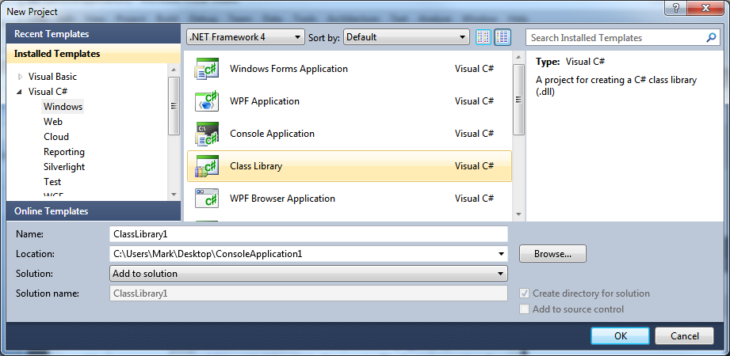
Sharing code with Libraries
Class Libraries allow common classes to be shared across applications
Class Library project generates standalone Assembly
public types are visible to all users of the library

Slide 48
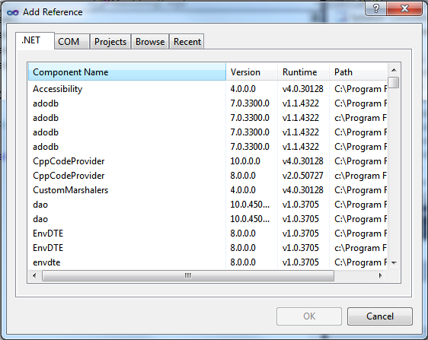
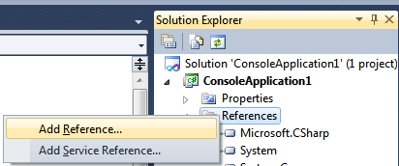
Using a Class Library
Class libraries must be referenced to be used
makes public types accessible to program
2
Select the location via the Tabs
1
Right-click on References Folder in project.. select Add Reference
3
Pick the assembly and press OK

Slide 49
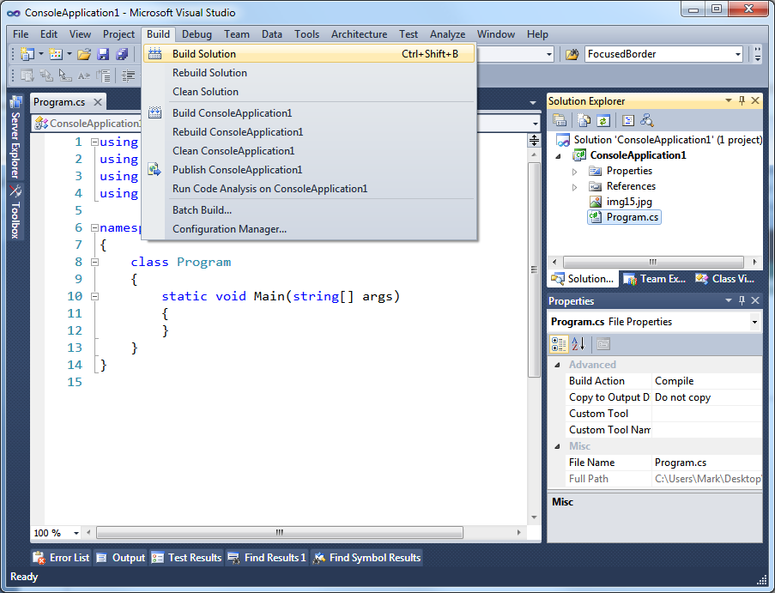
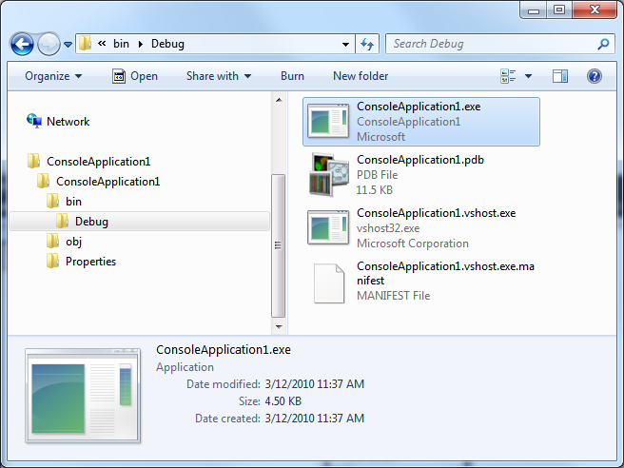
Building your solution
Build | Build Solution builds projects
can also build individual projects if desired
Generates an executable that can be run directly from Explorer

Slide 50
Dealing with failures
.NET uses exceptions to report runtime errors
InvalidCastException
IndexOutOfRangeException
NotSupportedException
ArgumentOutOfRangeException
ArgumentNullException
NullReferenceException
OutOfMemoryException
StackOverflowException
FormatException
...
MSDN documents exceptions issued from framework methods
some can be generated at any time

Slide 51
Handling Exceptions
Apps use try/catch/finally construct to manage failure
allows processing and potentially re-throw of exception
try
{ ISequence sequence = ReadNucleotideData();
}
catch (Exception ex) {
ReportFailure(ex.Message);
throw; }
finally
{
DoRequiredCleanup(); }

Slide 52
Throwing Exceptions
Common to throw System.Exception directly with text error
Consider deriving your own exception types from Exception
useful to report custom unrecoverable errors specific to your code
use the "except" code snippet in Visual Studio
throw new Exception("Error Detected in Sequence");
public class SequenceException : Exception
{
public ISequence Sequence { get; private set; }
...
}
...
throw new SequenceException(...);

Slide 53
Exceptions Warning
Unhandled exceptions will terminate the entire process
even in background threads
Some methods should never throw exceptions
constructors, finalizers, async callback handlers
Tip: only throw exceptions in exceptional circumstances
exception handling is very expensive
do not use exceptions for control flow
consider using error codes when the error is common
Try/Finally is actually very useful – even without exceptions
enforces a required post-method processing regardless of exit point

Slide 54
Runtime Debugging
Visual Studio 2010 supports a variety of debugging scenarios
Attaching to running processes
Local and Remote debugging
Managed and Unmanaged debugging
Post-mortem debugging from crash dumps
Client/Server debugging
T-SQL
… or just hit F5 to debug active solution!
Visual Studio 2010 adds several new features
parallel processing analysis
Intellitrace gathers back trace while running

Slide 55

Breakpoints
Breakpoints allow you to stop the program at given points under given criteria and examine its state
can add conditions to the breakpoint such as hit-count
To Set A Breakpoint: click in the border on the line where you want to set a breakpoint, or position the cursor on the line and hit "F9"
Right-click on the red circle to set conditions on the breakpoint

Slide 56
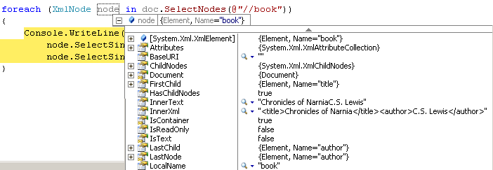
Examining Memory and Variables
Watch, Locals and Quick Watch Window allows you to examine values and complex data structures
hovering over variables also provides values in Data Tip
you can even change the current value by double-clicking in the field

Slide 57
Summary
Visual Studio provides an end-to-end IDE for all your Windows-based development needs
multiple languages, platforms and targets
.NET is a mature, powerful platform for building almost any style of application
provides runtime services (CLR)
supports multiple languages
framework include a plethora of classes
C# is generally the language of choice for .NET
provides the cleanest syntax today and most flexibility

Slide 58
Disclaimer: This document is provided "as-is". Information and views expressed in this document, including URL and other Internet Web site references, may change without notice. You bear the risk of using it.
This document does not provide you with any legal rights to any intellectual property in any Microsoft product. You may copy and use this document for your internal, reference purposes.
© 2011 Microsoft Corporation. All rights reserved.
Microsoft, Visual Studio, and Windows are trademarks of the Microsoft group of companies. All other trademarks are property of their respective owners.

